Slide 1
Brave new world: after 40 years, what do we know about Fasd
Leigh E. Tenkku Lepper, PhD, MPH, University of Missouri
Associate Research Professor, School of Social Work and Public Health
Principal Investigator: Midwest Regional FASD Training Center (MRFASTC)
Principal Investigator: Mental and Reproductive Health FASD Practice Implementation Center (MRPIC)
Quad Cities FASD Summit
September 26, 2014
Notes:
Welcome to the Quad Cities Summit on Fetal Alcohol Spectrum Disorders. It is my pleasure to be here with you and my great honor to have been asked to be your keynote speaker for today. Little did I know 20 years ago when I went back to school for my masters and doctorate, that I would end up in the field of Fetal Alcohol Spectrum Disorders and be standing here today speaking with you all. You never know where life will lead you!

Slide 2
My journey
1976: Married high school sweetheart who had collected a drinking problem.
Researched what was known about alcoholism and found the genetic link.
In the 70s: Keen interest in healthy pregnancies
2002: First heard about Fetal Alcohol Syndrome
Notes:
Everyone is always curious about how one chose a certain field of research. So, I thought I would share a short bit of my story with you on how I got here. My first marriage was in 1976 when I married my high school sweetheart about five years after high school and during which he had collected a drinking problem. Remember this was the Age of Aquarius and everyone was living FREE! After we married and I began to realize that the drinking problem wasn’t going to just go away, I began to spend a lot of time reading about alcoholism. After all, I had been successful at getting him off of seconal a recreational drug used in the 60s, so why not alcohol use? Unfortunately, that turned out not to be so easy and in the discovery process I learned about the genetic disposition to alcohol. At the same time, the 70s was a period of time when ‘natural childbirth’ was what everyone was talking about and I had a keen interest in having a healthy pregnancies. Anyone remember Adele Davis and “Let’s Have Healthy Children”? Or how about LeBoyer’s Birth without Violence method where he proposed having the baby delivered in a dim lit room avoiding the use of forceps and placing the baby immediately in a warm bath. OK, so I know how old YOU are! So, to me, having the healthiest baby possible was the only way to go. But it was many years later before I heard of the term Fetal Alcohol Syndrome. That occurred in 2002 when I was finishing my doctorate and took a position in Family Medicine at Saint Louis University. My boss, the chair of the department had just received a major grant from the CDC to conduct education and training on FASDs across the Midwest.

Slide 3
What is FAS/FASD?
Fetal Alcohol Syndrome (FAS) occurs as a result of a woman consuming alcohol during pregnancy which can result in significant effects on the developing brain of the infant.
Fetal Alcohol Spectrum Disorders (FASD) is an umbrella term much like Autism Spectrum Disorders in which there are a spectrum of conditions that may be diagnosed depending upon the differential effects of alcohol use during pregnancy.

Slide 4
Notes:
This is a representation of the prominent facial characteristics that are commonly associated with fetal alcohol exposure.

Slide 5
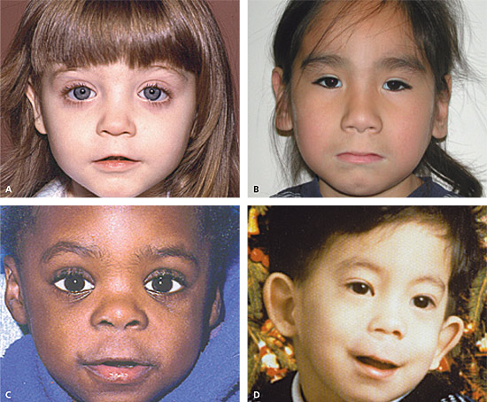

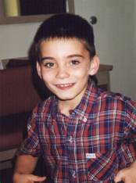
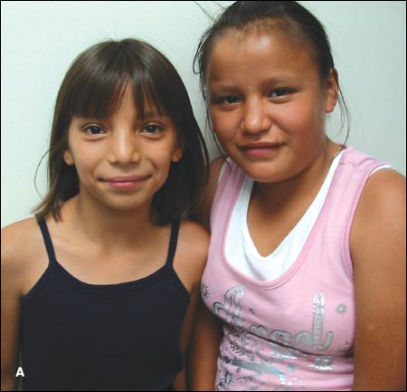

Slide 6
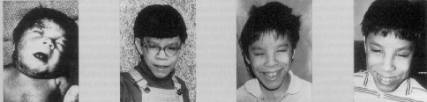
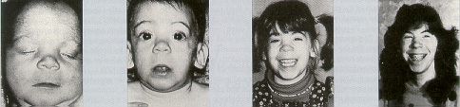
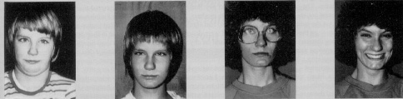
Longitudinal Growth - FAS
Notes:
These photos show the development of individuals diagnosed with fetal alcohol syndrome from infancy/early childhood to young adulthood. Even though FAS facial features may be apparent in early childhood, they may minimize or disappear later in life. These changes can make it difficult to diagnose FAS in postpubescent patients.
1. Row one shows a patient who was diagnosed with FAS as a newborn and at ages 5, 10, and 14 years. He has been growth deficient and microcephalic throughout his life. As he has aged, his nose has shown considerable relative growth, resulting in a high, wide nasal bridge. His philtrum has remained smooth.
2. Row two shows an adolescent girl as a newborn, at 9 months, and at 4 and 14 years of age. She was diagnosed with FAS at birth, with later intellectual functioning in the borderline range. Although her facial features are gradually maturing, she still has small palpebral fissures; a relatively long, smooth philtrum; and a narrow upper lip.
3. The third row shows a woman whose condition was diagnosed as FAS at 4 years of age. Photographs also show her at 9, 13, and 19 years. She has an IQ level of 85-90. Her early FAS facial manifestations have evolved into a fairly normal facial phenotype in adult life. At 19, her head circumference was below the 1st percentile, her height was below the 5th percentile, and her weight was around the 10th percentile.
[Source: Streissguth AP, Aase JM, Clarren SK, Randles SP, LaDue RA, Smith DF. Fetal alcohol syndrome in adolescents and adults. JAMA. 1991;265(15):1961-67; also in Striessguth AP. A long-term perspective of FAS. Alcohol Health & Res World. 1994;18(1):74-81.]

Slide 7
How Prevalent?
Incidence of Birth Defects
Down syndrome…….…….1/800 births
Cleft lip+/-palate………….1/800 births
Spina bifida………………..1/1000 births
Trisomy 18………………….1/3000 births
Fetal alcohol syndrome…..1-2/1000 births
  CDC approved estimates
  Many more with alcohol induced problems i.e. FASD
  Higher rates in some populations
Recent 2009 estimates are much higher
  1 in 100 births
Notes:
Fetal alcohol syndrome is the most common cause of mental retardation in the Western world, and is entirely preventable. It is clearly more common than such well known conditions as Down syndrome (trisomy 21), cleft lip with or without cleft palate and neural tube defects. Unfortunately screening and preventive measures for FAS lag behind these other conditions.

Slide 8
How much do women drink?

Slide 9
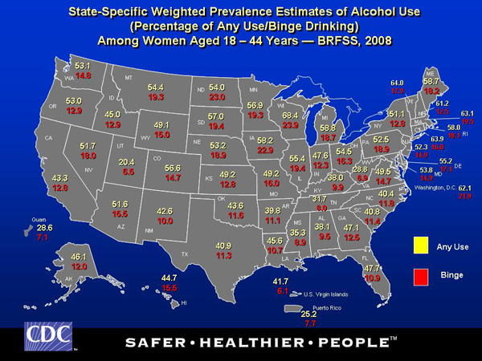
Notes:
CDC collects data from individuals annually on a particular set of health behaviors, one of which is alcohol use. The data set is known as the Behavioral Risk Factor Surveillance System or BRFSS for short.

Slide 10
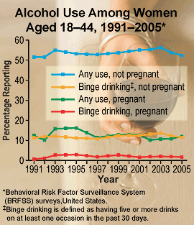
Notes:
Again using data from BRFSS, this slide shows alcohol use among non-pregnant and pregnant women over a period of about 15 years. Any use is defined as having one drink in the past 30 days and binge drinking is defined as having five or more drinks on at least one occasion in the past 30 days. Here you can see that about half of women in child bearing ages drink and about half do not drink at all. Of greater concern are those women who are the other three lines here: those who are binge drinking and not pregnant and also not using birth control, those who are pregnant and continue to drink any amount and those who are pregnant and continue to drink at binge levels.
Unfortunately, that red line has started to creep upward.

Slide 11
Notes:
This is the most recent report we have on alcohol use among women who are pregnant. This comes from SAMHSA reports and is based upon combined data from 2011 and 2012 from the National Survey on Drug Use and Health. What is shown here is that instead of 10% of pregnant women who are continuing drink into their first trimester, now it is 18%. And instead of the 2% of pregnant women drinking at binge levels, the riskiest level for having a child with FASD, now that rate has gone up to 7%. Those are very significant increases. And right now, we don’t have an answer for those increases.

Slide 12

Pregnant women who drink
Illinois: In 2011, 160,116 live births
  Any drinking first trimester: 28,661
  Binge drinking first trimester: 10,568
  3,521 cases of children with FASD
Iowa: In 2011, 38,033 live births
  Any drinking first trimester: 6,808
  Binge drinking first trimester: 2,510
  837 cases of children with FASD
Missouri: In 2011, 77,206 live births
  Any drinking first trimester: 13,641
  Binge drinking first trimester: 5,030
  1,677 cases of children with FASD
Notes:
Based upon the SAMHSA prevalence rates on pregnant women who drink, I ran the numbers for the three states of MO, IL and Iowa based upon numbers of live births in each state in 2011.
For Illinois, there were 160,000 live births: 28,661 of those births were exposed to any amount of alcohol and 10,568 were exposed to the riskiest level of alcohol use. The final statistic there is based upon what we currently know about the probability of women who drink having a child with FAS or FASD. We know that of those who do drink at the riskiest level of alcohol use, about 1/3 will have a child with fetal alcohol exposure. So for Illinois, the number of cases each year will be about 3500 children born with FASD. You may be asking why the 1/3 rate? And the reason for that is the complex mix of maternal variables that come into play which includes, the amount of alcohol the mom drank prior to becoming pregnant, the type of alcohol, whether it is wine, beer, or hard liquor, when she drank, how her body metabolizes alcohol, her nutritional status, and genetics. All of these factors play a role in the effect of maternal alcohol use and the birth outcome.

Slide 13
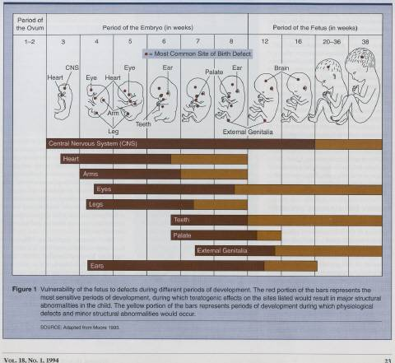
Notes:
This is a growth chart of the fetus and gives us information on what is developing at any given stage in the pregnancy. As you can see by week 8, every organ, every tissue, every nerve, every system is in place. Now let me ask you, when do you women find out they are pregnant? The average is around week 6.

Slide 14
Notes:
We continue to investigate which women are most at risk for having a child exposed to alcohol. This is a study we just concluded and was done by the lead author, Louise Flick at Saint Louis University, also my dissertation mentor. Looking at a small sample of women (n=744) attending WIC clinics in the city of St. Louis and in the rural Bootheel of Missouri, we found the three prominent risk factors for continuing alcohol use after pregnancy confirmation was highest in women who were exposed to intimate partner abuse both prior to and during pregnancy, 7 times higher in women who smoke, and 6 times higher in women who have a drug abuse habit.

Slide 15
How big is this problem?

Slide 16
Long-Term Prognosis
Secondary Disabilities associated with FASDs
Mental health problems—94%
Trouble with the law—83%
Sexual misconduct—49%
Disrupted school experiences—61%
Problems with alcohol and/or drug use
Dependent living and employment for life
Notes:
16
A Study from the University of Washington in Seattle examined case histories of 415 individuals with FAS/FAE ages 6 to 51 years old. In reviewing the outcomes for the adolescents and adults, a disturbing predominance of secondary disabilities was noted.
How do we get from the primary CNS effects of alcohol exposure to this level of difficulty as teens and adults? There is a critical need to understand the pathway that leads to these secondary disabilities and possible protective factors in order to plan for intervention and prevention.
Streissguth, Ann (1997). Fetal Alcohol Syndrome: A Guide for Families and Communities, Brookes Publishing
Streissguth, A, Barr, H, Kogan, J, and Bookstein, F (1996). Understanding the Occurrence of Secondary Disabilities in Clients with Fetal Alcohol Syndrome and Fetal Alcohol Effects, Final report to the Centers for Disease Control and Prevention. University of Washington School of Medicine.

Slide 17


Long term prognosis with the right supports
But many live very successful and fruitful lives.
Morgan Fawcett, Native American Flute Player and Spokesperson for Youth with FASD

Slide 18
Costs of FASD
FAS costs US $5.4 billion in 2003
An FAS birth carries lifetime health costs of $860,000 although can be as high as $4.2 million
Plausible to assume that FAS reduces “discounted” lifetime productivity $200,000; lost wages & subsidies
Even “expensive” FAS prevention may be “cost effective”

Slide 19
What do we know in 2014?

Slide 20
Terminology
1973 - Fetal Alcohol Syndrome (FAS)
  Partial FAS = pFAS
1978 - Fetal Alcohol Effects = FAE
1989 - Alcohol-related birth defects = ARBD
1996 - Alcohol-related neurodevelopmental disorder = ARND
2004 - Fetal alcohol spectrum disorders = FASD

Slide 21
Diagnostic criteria
IOM Guidelines - 1996
4-Digit Code – Astley & Clarren 2000
National Task Force on FAS/FAE – Bertrand 2004
IOM Guidelines Revised – Hoyme 2005
Canadian diagnostic guidelines – Chudley 2005
Notes:
Institute of Medicine guidelines first came out in 1996, but descriptions were not operationalized into any set of useful criteria.
In 2000, Susan Astley and Sterling Clarren at the University of Washington created a very detailed diagnostic system known as the four digit code that is used in many clinics.
In 2004, a National Task Force on FAS and FAE chaired by Jacqui Bertrand of the CDC published the booklet, “Fetal Alcohol Syndrome: Guidelines for Referral and Diagnosis.”
Then in 2005, Gene Hoyme and colleagues published a clear set of diagnostic criteria based upon the IOM guidelines and specifically useful in pediatric clinical settings.
At the same time, Albert Chudley in Canada published a set of diagnostic criteria in the Canadian Medical Association Journal.

Slide 22
Comparison of diagnostic four systems
Similarities:
  Growth retardation: 4/4 ht and wt < 10th percentile
  Alcohol Exposure: 4/4 confirmed or unconfirmed alcohol exposure
Differences:
  Facial: ¾ use same facial characteristics (short palpebral fissures, thin vermillion border, smooth philtrum
  CNS involvement: different criteria for each

Slide 23
Case Ascertainment
Significant improvements in how we find cases of FAS/FASD
Three-dimensional computer recognition
How do we identify alcohol exposure when the facial dysmorphology is missing?
Biomarkers to indicate exposure and eliminate reliance on self-report
  Measure blood, urine, hair
  Examine metabolic, proteomic, epigenetic profiles
Notes:
Due to better clinical diagnostic criteria we improved the way in which we find cases of FAS and FASD.
Majority of alcohol consumed by the mom and the fetus is metabolized into carbon dioxide and water making it difficult to try to measure. However, alcohol in the blood, urine and hair can remain for days to weeks which may be a more competent method for measuring alcohol exposure to the fetus.
We still need to find more reliable methods for determination of alcohol exposure. This plus examination of individual metabolic, proteomic (study of protein structure and function) and epigenetic profiles of the women who do drink during pregnancy will tell us a great deal more about the effects of alcohol upon the developing fetus.
Epigenetics means anything “on top of or in addition to genetics”. So this field of study is looking at processes or mechanisms other than DNA codes in other words, other than heredity, in the developing organism.

Slide 24
Notes:
These are examples of the use of three-dimensional facial imaging software.
The one on the left is the final 3D image generated from six photographs stitched together in the software and takes less than 2 minutes to create.
The example on the right is one where they use specific landmarks identified on the image and then connect these landmarks with lines and general shapes. Sterling Clarren proposed this idea in 1987, and Mutsvangwa and Douglas finally designed and published their work in 2007. Using an approach known as morphometrics, you can ‘look at differences between the shapes found in faces of children prenatally exposed to alcohol and compare to children non exposed’.

Slide 25
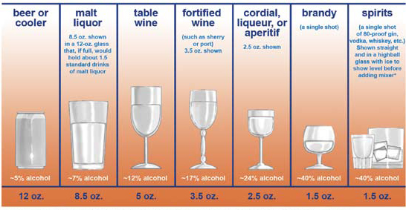
What is a Drink?
Before screening, women should be taught what constitutes a typical drink
A standard drink is defined as
  one 12-ounce bottle of beer
  one 5-ounce glass of wine
  1.5 ounces of distilled spirits
Notes:
American College of Obstetricians and Gynecologists (2006). Drinking and reproductive health: A fetal alcohol spectrum disorders prevention tool kit. Washington, DC: American College of Obstetricians and Gynecologists. http://www.acog.org

Slide 26


The new wine glass
26 ounce wine glass

Slide 27
What are the consequences of prenatal alcohol exposure?

Slide 28

Relationship between mother’s drinking
and fetal development
Brain
Nerves
Brain
Stomach
Placenta
Fetus
Breast
Heart
Organs
Liver
Muscles
Kidneys
Notes:
28
Fundamentally, since FAS/FASD’s don’t happen in the absence of maternal drinking, the cause of these conditions, the necessary element, is alcohol. So we need to know a bit about alcohol metabolism in the mother. Where does ‘1 drink’ of alcohol go? This simplistic diagram demonstrates what happens to ‘1 drink’ of a beverage containing ethanol.
Note that ingestion by a pregnant female that the alcohol contained in the beverage enters the ‘stomach’. Beginning in the stomach and continuing throughout the digestive tract, the ethanol is ‘absorbed’ into the blood vascular system, and ‘distributed’ to all tissues of the mother’s body…including the ‘brain, nerves, muscles, heart, liver’…even to the ‘breast’ and the milk, if the mother is lactating. Eventually, the ethanol molecule is ‘metabolized’, some within the tissues, but mostly as it passes through the liver.
Of significance, one area of the body the absorbed alcohol is readily distributed to, is the placenta. The placenta, while offering protection against a variety of potential harmful substances and some infectious agents, does NOT stop the transfer of ethanol. Ethanol readily crosses the placenta, and similar to the mother, ethanol is distributed to all tissues or organs within the developing embryo or fetus.
Some scientific evidence indicates that since there is a reduced ability of the fetus to metabolize ethanol (since much of the metabolism occurs in the liver, and the fetal liver has limited ability to function in that manner), that ethanol levels in the fetus may exceed the concentrations found in the mother. Furthermore, the fetal ethanol levels may take a longer period of time to be metabolized and reduced than in the mother because of the limited fetal liver function, and the necessity for the alcohol to leave the fetus to re-enter the maternal tissues to be metabolized.
Because of the ability for ethanol to be easily absorbed and distributed throughout all parts of the mother’s body, including the developing embryo or fetus, even one drink will reach and potentially affect the tissue or organs of the fetus.
[Source: Alcohol Metabolism, Alcohol Alert, NIAAA, 35:1997; Akesson, C. Autoradiographic studies on the distribution of 14C-2 ethanol and its non-volatile metabolites in the pregnant mouse. Arch. Int. Pharmacodyn. Ther. 209:296-304, 1974; Pikkarainen PH and Raiha, NCR. Development of alcohol dehydrogenase activity in the human liver, Pediatr Res 1: 165-168, 1967; Little BB. Vanbeveren TT. Placental transfer of selected substances of abuse. Seminars in Perinatology. 20:147-153, 1996].

Slide 29
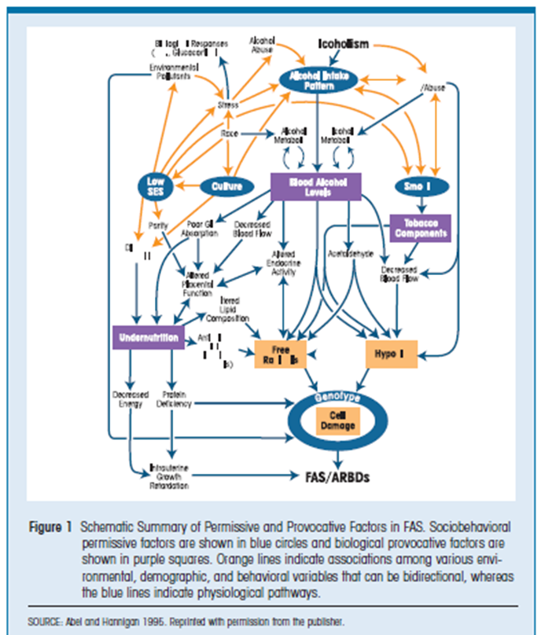
Notes:
This diagram is actually not new. It is from an article by Able and Hannigan in 1995 that outlines a schematic drawing of the interaction of a number of maternal factors. They proposed a number of what they termed as ‘permissive’ and ‘provocative’ variables that would increase the likelihood of having a child with FAS/FASD. Permissive variables included thinks like ‘predisposing behavioral, social, and environmental factors while provocative variables included those that ‘are related to physiological changes in the internal milieu..that increase vulnerability to alcohol’s toxic effects’. The summary of their work underscored the relationship between low SES, undernutrition, advanced maternal age, high parity (more than one child), and overall weathering increase the risk for FASD trait expression….
Weathering for those who have not heard this term before, is the idea of the cumulative effect of poor living conditions, inadequate nutrition and high levels of stress on childbearing.
Arline Geronimus. Black/white differences in the relationship of maternal age to birthweight: a population-based test of the weathering hypothesis. Soc Sci Med 1996;42(4):589–597

Slide 30
Reduced IQ for full FAS
Cognitive and learning disabilities
Severe behavior problems
70% have a diagnosis of ADHD in children
Oppositional Defiant/Conduct disorder next most common next to ADHD

Slide 31
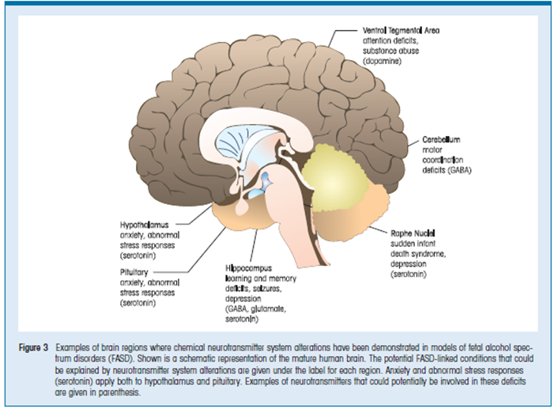
Notes:
This is a diagram of a normal human brain. The areas that are identified in this diagram are regions in the brain where we have found chemical alterations in those diagnosed with FASD.

Slide 32
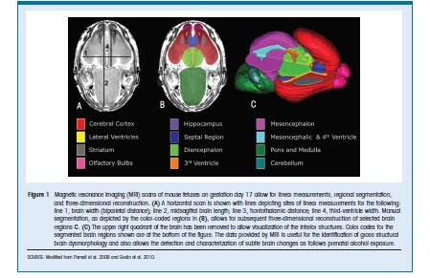
Use of imaging technologies (MRI) to show the neurological damage caused by PAE
Notes:
This is a slide from Parnell et al 2009 and Godin et al 2010 where MRI scans are shown of mouse fetuses on gestation day 17 which is late in the fetal development stages for the mouse fetus. These images take anywhere from 2-3 hours to produce a high-resolution image of the fetus. This type of imaging will allow us to identify structural brain dysmorphology and to detect the brain changes that can occur due to prenatal alcohol exposure.

Slide 33
Notes:
This is taken from a study conducted by Sara Mattson, et al 1994. These are pictures of brain scans of prenatal alcohol-exposed adolescent-aged mice on the left compared to what these areas look like in children. So. From the top. A and B are a normal mouse and a normal child’s brain. What I want you to watch here is the dark gray section of the brain known as the corpus callosum, the part of the brain that integrates information from one side of the brain to the other. Following down on the left from A to C to E, watching the middle white arrow, you can see the normal corpus callosum in a mouse fetus, starting to disappear in the model C and completely disappearing in model E. Now follow the same sequence in the child on the right. These defects are remarkably similar in the two FAS patients, model D and F.

Slide 34
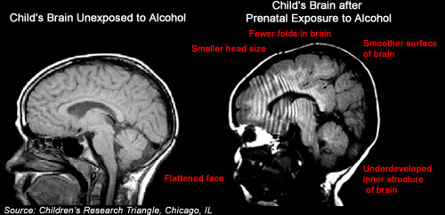
Notes:
This is yet another MRI set of images taken from Children’s Research Triangle in Chicago. The one on the left is a child’s brain unexposed to alcohol. Compare to the one on the right where the child was prenatally exposed to alcohol and you find the following deficits.

Slide 35
Prevention Efforts
1981 and 2005: Surgeon General Warnings
2002-2014: Regional Training Centers (RTCs)
Project Choices (2007)
ACOG Recommendations: Women and Alcohol Toolkit
Screening Brief Intervention Referral and Treatment (SBIRT)
American Academy of Pediatrics Toolkit and Algorithm
2014-2018: Practice Implementation Centers (PICs)
Notes:
Six New CDC funded Practice Implementation Centers
University of Missouri
University of Nevada
University of Alaska
University of Wisconsin
Baylor College of Med (where Roger Zoorob moved to)
University of Calif, San Diego (Ken Jones, Tina Chambers)
Five New CDC funded National Partners
Two medical societies (ACOG and AAP)
Two universities (UT-Austin will coordinate with social workers
Univ of Pittsburgh’s School of Nursing will coordinate work with nurses.
NOFAS under component 2 of the national partners cooperative agreement (DD14-1403).

Slide 37

The first Think Before You Drink pregnancy test dispenser in a women's restroom in a community college was placed in Central Lakes College in Brainerd, MN.

Slide 38
Intervention Efforts
Bertrand 2004: School-age Interventions
Project Bruin Buddies – social skills training
Georgia Math Interactive Learning Experience – math knowledge and skills training
ALERT program – behavior regulation and executive functioning
Families Moving Forward: Parent therapy program – improve parent effectiveness and reduce behavior problems
CDC 2009: Two national projects funded for youth and young adults with FASD
  O’Connor: Project Step Up
  Tenkku: Partners for Success Intervention
Notes:
Project Step Up was a six week program for youth and their caregivers focused on ways to help the youth quit or reduce their drinking. 54 enrolled in the study, those youth in the intervention program did show reduction in alcohol use at the end of the intervention, but was not sustained 3 months later. Youth reported alcohol use but compared to parent report of alcohol use, was much higher. Parents clearly did not know about the youth and their alcohol use.
Partners for Success study was a six month home-based therapy and mentor program. Therapist met with family and youth every other week using a manual designed specifically for the study to help youth and family address maladaptive behaviors (bullying, not attending school, problems with peers, employment issues). At end of intervention and at three months out:
PFS Youth/Young Adult did improve somewhat or remained stable over time with the intervention but were not significantly different than controls.
PFS parents remained stable in terms of their ability to manage the child’s behavior.

Slide 39
Therapeutic interventions
Complex motor skills training (Klintsova, 2000). This training can stimulate formation of new nerve cell connections in the cerebellum
Brain’s ability to adapt; neuronal plasticity
Choline supplementation (Thomas et al 2007)
Notes:
Anna Klintsova is a neuroscientist at the University of Delaware whose research is focused on FAS/FASD.
We had her to come and speak at a conference in Kansas City this past March. Her research since 1995 has focused on using rat modeling to understand the extent of the damage alcohol can cause and whether an intervention—in particular, providing a stimulating environment—may help to improve the damage occurring before birth. In her work, she looks at the motor abilities and memory of alcohol-exposed rats and then at the cellular and sub-cellular levels to see if the stimulating environment improves the neuron connections in the brain.
Dietary supplementation with choline may decrease hyperactivity and improve spatial and working memory in rats exposed to alcohol during development. So far the choline supplementation has been shown to be most effective in the hippocampus region of the brain.

Slide 40
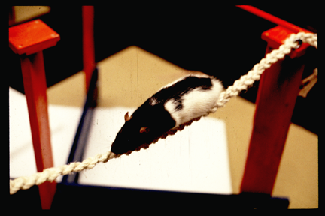
Complex motor task learning
(Acrobat Condition)
Notes:
Anna Klintsova March 2014 Talk

Slide 41
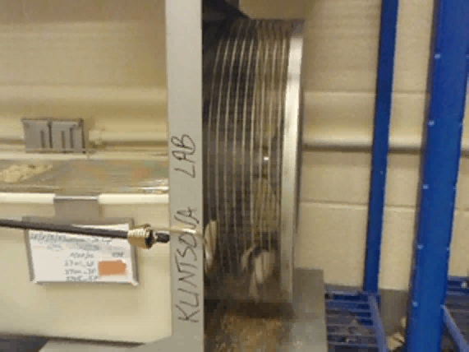

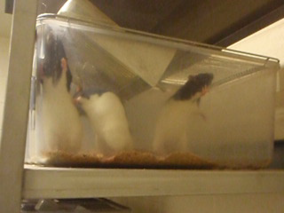
Behavioral Interventions to Ameliorate Alcohol Effects on Brain and Behavior
Notes:
Anna Klintsova Talk March 2014
Picture of rats in multi-level housing and with lots of toys and stimulating activities.

Slide 42
Other Treatments
Ways to minimize alcohol damage: With a word of caution. Unlikely that any treatment intervention will be able to address the multiple teratogenic effects of alcohol
Use of agents such as antioxidants, anti-inflammatory agents, the nutrient choline to reduce fetal cell toxicity (Yeaney et al, 2009)
Neuropeptides that provide protection from alcohol-induced fetal injury (Sari & Gozes, 2006)

Slide 43
After 40 years,what do we know?
Alcohol disrupts developmental processes through multiple sites of action (Warren, et al, 2011).
Despite multiple media levels of health warnings, women continue to drink into their pregnancies.
New technological advances in identification of FAS/FASD.
May be new therapeutic options for those with FASD.
Ultimate best message is still prevention of alcohol use during pregnancy.

Slide 44
Thank you!
Questions??

