Slide 1
Welcome to
Black Hawk College!
Please put your headphones on as there is an audio portion to this presentation.
If you have questions during the presentation, please see the advisor.
Notes:
If student is in wrong session, send to Advising Center..
Hand each student a catalog and registration guide.
Be sure each student gets an information card (Name and Major). Have them pass it in. You will sort these according to major and later you will pair up students.
Transfer students who don’t know their major are encouraged to stay.
Students who realize they are not in the right group (i.e. career students students) have the option to stay, reschedule into a career NewSTARS, or meet with individual advisor.

Slide 2
If you register today, then you pay today!!
Payment for fall is due!,

Slide 3
What will you learn today?
What student services are available to support my success?
What educational paths does Black Hawk College offer?
What kind of degrees can l earn?
How do I determine how many classes to take based on my life situation?
How does payment work?
Notes:
No need to go into details yet – just an overview
(not sure about Welcome week)

Slide 4
Student Support Services available at Black Hawk College
Tutoring
Located below the library in The Student Success Center Building 1 at the Quad-Cities Campus.
Tutoring is available for all subjects and is FREE!!
Be sure to schedule time in your school day to visit a tutor.
Notes:
This is a clicker slide.
We have many services at Black Hawk College to help you throughout your education. Refer them to the website to learn more. (ANSWER is Childcare)

Slide 5
Student Support Services available at Black Hawk College
Disability Services
Black Hawk College has many students with either physical or learning disabilities.
Students with disabilities may use a variety of accommodation services intended to reduce the effects that a disability may have on their performance in a traditional classroom or online setting.
If you would like more information, talk to your advisor for a referral to Susan Sacco, our Disabilities Services Coordinator (309) 796-5900.

Slide 6
Student Support Services available at Black Hawk College
The Career Services Center,
Located in the upper level of the First Stop Center
assists individuals who:
are uncertain about career goals
You make take a computerized, career-decision making assessment
want to become more employable
You may get assistance with resume preparation and job hunting
are seeking entry-level positions
You will find many positions advertised on our website, www.CollegeCentral.com

Slide 7
Advising
You will see an advisor today to determine your first semester classes.
You will want to see an advisor each semester to see that you are on track.
See an advisor if you change your major or your transfer school.
Tip:
Make an appointment with an advisor
once the school year begins to do long-term planning!

Slide 8
Advising
What can I
expect from my advisor?
Your advisor will:
Help you define and develop your goals, and help you in decision-making
Provide academic information related to your goals
Teach you how to navigate the enrollment process
Provide referrals for additional services such as counseling or tutoring as appropriate
Give priority to privacy and confidentiality
What does my advisor
expect from me?
Your advisor expects you to:
Take personal responsibility for making decisions
Prepare questions and bring appropriate materials to all advising sessions
Set future goals and develop action plans to achieve them
See your advisor on a regular and timely basis
Follow through on recommendations made by your advisor

Slide 9
Career vs. Transfer Degrees
Black Hawk College has two basic pathways for education.
Career Path – for those students wishing to receive training to work toward immediate employment upon graduation.
Associate of Applied Science (AAS)
Certificate
Transfer Path – for those student wishing to transfer to complete a Bachelor’s degree from another university/college.
Associate of Arts (AA)
Associate of Science (AS)

Slide 10
Degree/Certificate
Comparison Chart
This chart illustrates how BHC degrees are different from each other.
This shows only the Career programs.
Career Program Degree
Associate in Applied Science
(AAS)
64
credit
hours
Career Major
Courses
Career Program
Certificate
30
credit
hours
Career Major
Courses
General Education
Courses
15 credits
Notes:
Explain the difference in degrees.
Focus on the fact that with the AA/AS, there will be more general education courses. The electives may prepare you for your major (curriculum requirements).

Slide 11
Benefits of Career Programs
Certificates or Associate in
Applied Science (AAS) degrees
Gain current knowledge and skills to enter a particular occupation.
Designed for immediate employment or job upgrading.
Gain valuable on-the-job experience with an internship or clinical course.
In most cases, complete studies in two years or less.
Notes:
Exceptions to completing in 2 years or less:
Attend part-time
Need developmental courses
Pre-requisite courses to complete for various allied heath careers such as ADN, Rad Tech, Dental Hygiene, PTA, etc.
Timing of application cycles for being accepted into some programs like ADN, LPN, PTA
Some programs are very sequential (i.e. Engineering Technology), or courses are offered only in Spring or Fall, so when you complete your studies may depend on which semester you began.

Slide 12
Degree/Certificate
Comparison Chart
Transfer Degree
Associate in Art (AA)
Associate in Science (AS)
This chart illustrates how BHC degrees are different from each other.
Note the different requirements for
general education.
120
credit
hours
Bachelor of
Arts
B.A.
Bachelor of
Science
B.S.
Career Program Degree
Associate in Applied Science
(AAS)
64
credit
hours
64
credit
hours
Career Major
Courses
Transfer Major or
Elective Courses
20-21 credits
Career Program
Certificate
General
Education
Courses
43-44 credits
30
credit
hours
Career Major
Courses
General Education
Courses
15 credits
Notes:
Explain the difference in degrees.
Focus on the fact that with the AA/AS, there will be more general education courses. The electives may prepare you for your major (curriculum requirements).

Slide 13
Benefits of Transfer Programs
AA and AS degrees
Associate in Arts and Associate in Science (AA/AS) degrees facilitate transfer to four year colleges and universities.
You will be admissible to an Illinois Public University
Most lower division general education courses will be completed
You will be prepared to complete a bachelor’s degree

Slide 14
How many credit hours Should I take?

Slide 15
Definition
Credit Hour
Measures how much time in class you have every week
for a course. Examples are:
ENG 101 - English Composition 1
(3 credit hour course)
about 3 hours of instruction per week
BIOL 101 – General Human Biology
(4 credit hour lab course)
Lab courses add time -3 hours of instruction plus 2 hours of lab per week

Slide 16
Full-time vs. Part-time
Students may be either fulltime or part time students at Black Hawk College.
Fulltime = Fall/Spring (12 -18 credits for 16 weeks)
= Summer (6-9 credits for 4-6 weeks)
Part time = Fall/Spring (11 or fewer credits for 16 weeks)
= Summer (5 or fewer credits for 4-6 weeks)
Taking fewer credits per term means it will take longer
to complete the degree.

Slide 17
Withdrawing from a Class
If you withdraw from a class once the term has begun,
You will use an add/drop form and you must turn it in to Enrollment Services.
If the class is over 2/3 complete, get your instructor to sign it.
We recommend you see an advisor and talk with your instructor before withdrawing.
The refund policy states, “To receive the following percentage of tuition and fees…” (for a 16 week semester)
100% – Drop your course before the term begins.
75% – Through the seventh calendar day of the term counting the first day of the term as day one.
50% – You must drop your course between the eighth and 14th day of the term.
Withdrawing from a class may affect your Financial Aid. You must have a 67% completion rate to continue.

Slide 18
Paying for College
Fall 2014– Payment is due Thursday, August 7, 2014.
After this date, payment is due upon registration
(August 9th-August 22).
Tuition cost per credit hour: In-district — $120 Illinois out-of-district — $230 Iowa contiguous counties — $160 All other out-of-state and international students — $235 Online (Illinois residents) — $135 Online (out-of-state) — $160

Slide 19
Deferred payment plan
The deferred payment plan is offered only in the spring and fall semesters.
Payments are divided into three installments.
You must sign up through myBlackHawk under Student Records.
You will pay the first installment of your account balance plus a $25 non-refundable setup fee.
Promissory notes may also be set-up through myBlackHawk.

Slide 20
Quick Financial Aid Facts
If you have not yet filled out your FAFSA form, you need to do it online ASAP at www.fafsa.gov
You do not need to be a fulltime student to be on Financial Aid
If you receive a student loan, however, you need to have at least 6 credits per term
If you have Financial aid to cover them, you may get your books at the Hawk’s Hub (BHC Bookstore) starting August 18th.
Bring your photo ID and your BHC ID number, along with your printed book list.

Slide 21
To remain in good standing for Financial Aid, you need to . . .
Maintain a cumulative GPA of 2.0 or higher
Complete and Pass 2/3 of the courses for which you register (67% Completion Rate) to remain on Financial Aid
Discuss any concerns with your advisor

Slide 22
Instructions
Look at the My Weekly Time Commitments chart on the back of the pink NewSTARS guide.
You will go over this with your advisor.
The video on the next slide will take you through an explanation.

Slide 23
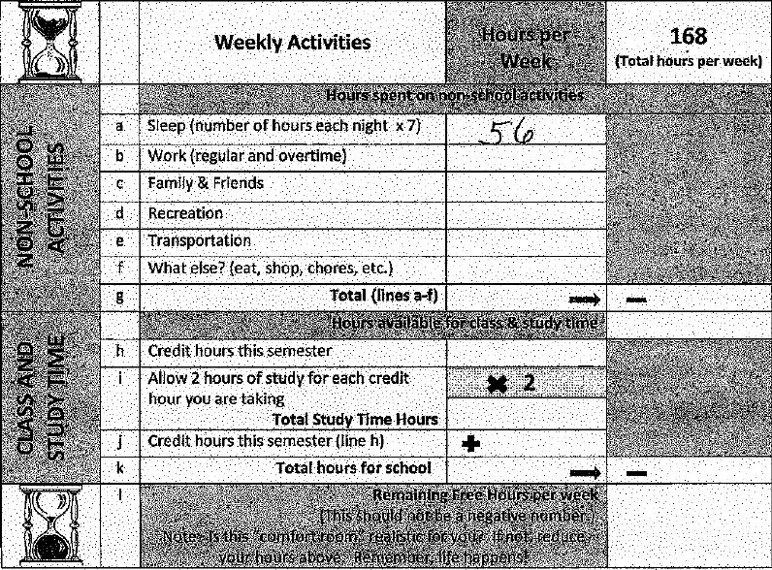
My Time Commitments
Your completed chart may look something like this.
Have you committed enough time each week to be a successful student?

Slide 24
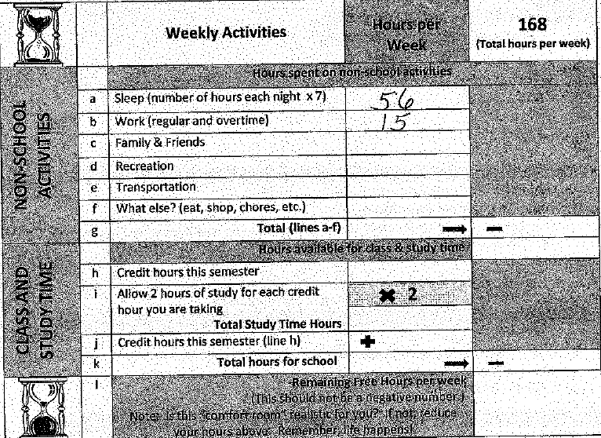
My Time Commitments
Your completed chart may look something like this.
Have you committed enough time each week to be a successful student?

Slide 25
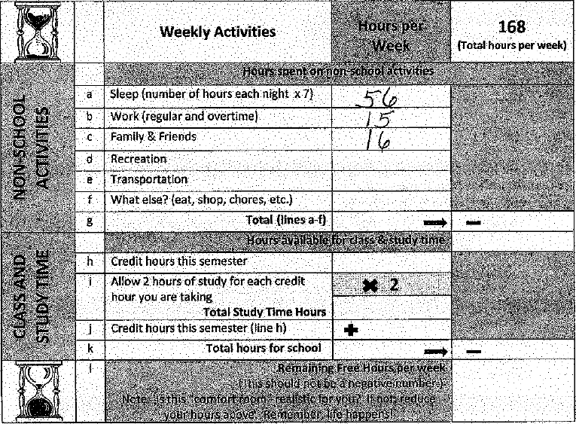
My Time Commitments
Your completed chart may look something like this.
Have you committed enough time each week to be a successful student?

Slide 26
My Time Commitments
Your completed chart may look something like this.
Have you committed enough time each week to be a successful student?

Slide 27
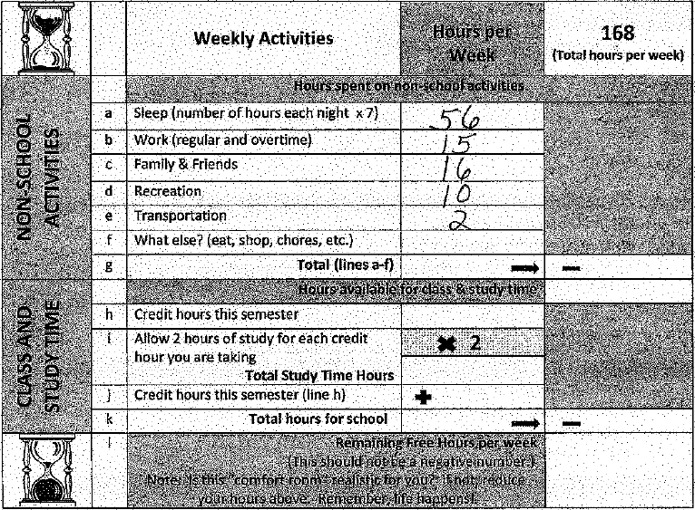
My Time Commitments
Your completed chart may look something like this.
Have you committed enough time each week to be a successful student?

Slide 28
My Time Commitments
Your completed chart may look something like this.
Have you committed enough time each week to be a successful student?

Slide 29
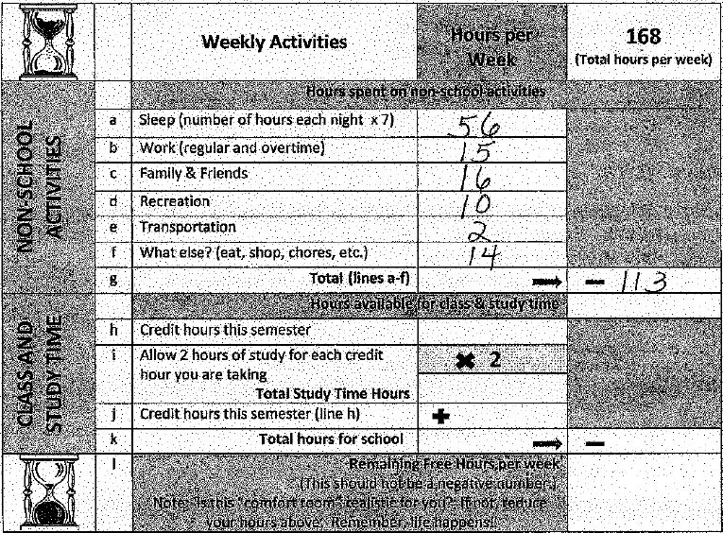
My Time Commitments
Your completed chart may look something like this.
Have you committed enough time each week to be a successful student?

Slide 30
My Time Commitments
Your completed chart may look something like this.
Have you committed enough time each week to be a successful student?

Slide 31
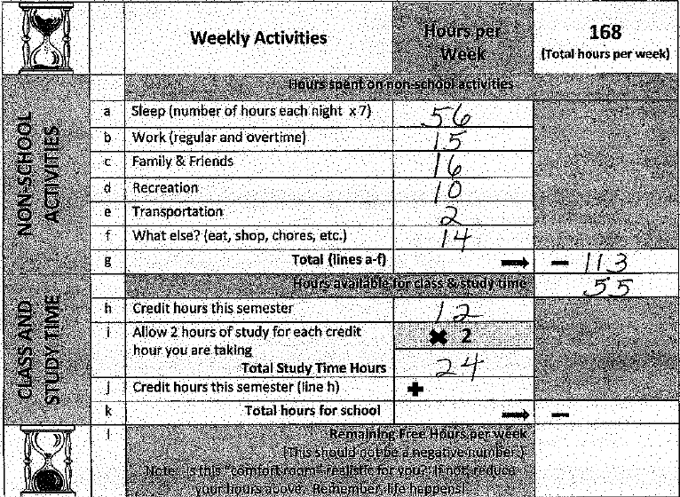
My Time Commitments
Your completed chart may look something like this.
Have you committed enough time each week to be a successful student?

Slide 32
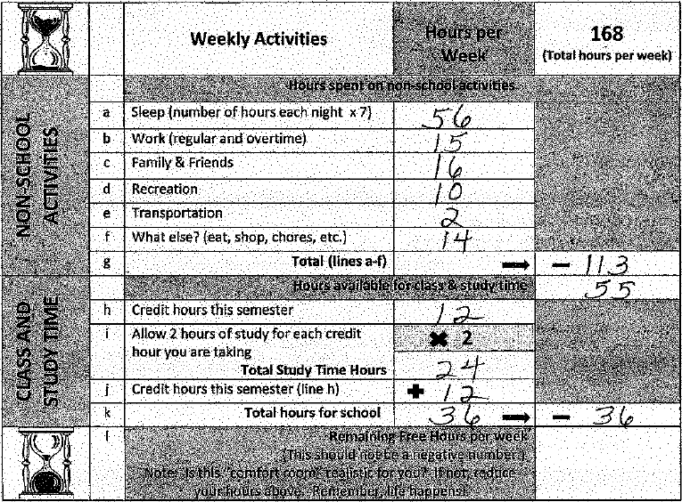
My Time Commitments
Your completed chart may look something like this.
Have you committed enough time each week to be a successful student?

Slide 33
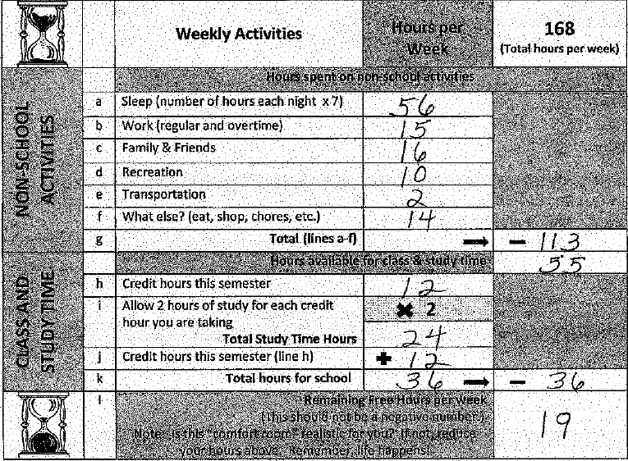
My Time Commitments
Your completed chart may look something like this.
Have you committed enough time each week to be a successful student?

Slide 34
Next Steps . . .
Look at the Green sheet in your folder.
Read to get information on
Parking
BHC Money Card/Student ID
Hawk’s Hub (Bookstore) information
See dates for Welcome Week Orientation
you may sign up at www.bhc.edu/orientation

Slide 35
Check out your major
Instructions
Go to www.bhc.edu
Click on Quick Links in the Center
Click on Programs of Study
Find your major (or if you are undecided, you can look at options)

Slide 36
Final Steps . . .
Go back to First Stop Center desk to let them know that you are ready to see an advisor once you have completed the following:
Filled out your Weekly Time Commitments table
Found your major online
Notes:
Be sure that everyone completes the Zoomerang survey.

